Slide 1
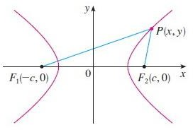
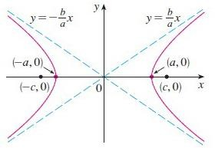
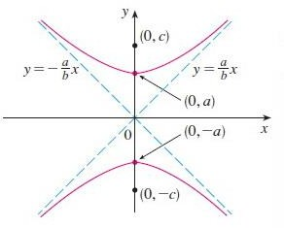
Hyperbola
A hyperbola is the set of all points in the plane such that the difference of its distances from two fixed points (foci) is a given positive constant denoted 2a. The distance between the two foci is 2c and that between the two vertices is 2a. The eccentricity of a hyperbola is (e > 1).
When we draw a hyperbola it is useful to first draw its asymptotes, which are the dashed lines in figures below
1- The Hyperbola has foci (∓𝒄, 𝟎), 𝒘𝒉𝒆𝒓𝒆 𝒄^{𝟐} = 𝒂^{𝟐} +
𝟐
𝒃
𝒃 , 𝒗𝒆𝒓𝒕𝒊𝒄𝒆𝒔 (∓𝒂, 𝟎), 𝒂𝒏𝒅 𝒂𝒔𝒚𝒎𝒑𝒕𝒐𝒕𝒆𝒔 𝒚 = ∓ ( ) 𝒙
𝒂
^{𝒙𝟐} − ^{𝒚𝟐} = 𝟏
_{𝒂}𝟐 _{𝒃}𝟐
2- The Hyperbola has foci (𝟎, ∓𝒄), 𝒘𝒉𝒆𝒓𝒆 𝒄^{𝟐} = 𝒂^{𝟐} +
𝟐
𝒂
𝒃 , 𝒗𝒆𝒓𝒕𝒊𝒄𝒆𝒔 (𝟎, ∓𝒂), 𝒂𝒏𝒅 𝒂𝒔𝒚𝒎𝒑𝒕𝒐𝒕𝒆𝒔 𝒚 = ∓ ( ) 𝒙
𝒃
^{𝒚𝟐} − ^{𝒙𝟐} = 𝟏
_{𝒂}𝟐 _{𝒃}𝟐

Slide 2
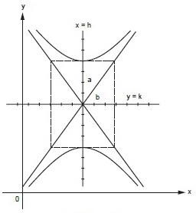
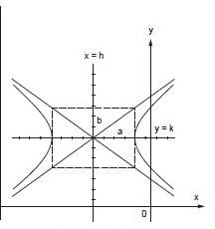
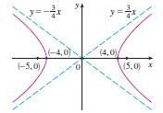
When the focal axis is parallel to the y-axis, the equation of the hyperbola with center (h, k)
(𝒚 − 𝒌)^{𝟐} (𝒙 − 𝒉)^{𝟐}
− = 𝟏
_{𝒂}𝟐 _{𝒃}𝟐
If the focal axis is parallel to the x-axis and center (h, k), then
(𝒙 − 𝒉)^{𝟐} (𝒚 − 𝒌)^{𝟐}
− = 𝟏
_{𝒂}𝟐 _{𝒃}𝟐
Example Find the foci and asymptotes of the hyperbola 9𝑥² − 16𝑦² = 144 and sketch its graph.
Solution
If we divide both sides of the equation by 144, it becomes
_{𝑥}2 _{𝑦}2
− = 1
16 9
which is of the form with a = 4 and b = 3. Since c² = 16 + 9 = 25, so c = 5, the foci are (∓5,0).
3
The asymptotes are the lines 𝑦 = ³ 𝑥 and 𝑦 = − 𝑥. The graph is shown in Figure
4 4

Slide 3
Example Find the foci and equation of the hyperbola with vertices (0, ∓1) and asymptote y = 2x
Solution we see that a = 1 and b = 2. Thus b = a/2 = 1/2 and c² = a²+ b² = 5/4. The foci are (0, ∓√5/2) and the equation of the hyperbola is 𝑦² − 4𝑥² = 1
Translated conics
1- Parabolas with vertex (h, k) and axis parallel to x-axis
(y − k)² = 4p(x − h)
(y − k)² = −4p(x − h)
[Opens right]
[Opens left]
2- Parabolas with vertex (h, k) and axis parallel to y-axis
(x − h)² = 4p(y − k)
(x − h)² = −4p(y − k)
[Opens up]
[Opens down]
3- Ellipse with center (h, k) and major axis parallel to x-axis
(𝒙−𝒉)^{𝟐} ₊ (𝒚−𝒌)^{𝟐} ₌ ₁
[b < a]
_{𝒂}𝟐 _{𝒃}𝟐
4- Ellipse with center (h, k) and major axis parallel to y-axis
(𝒚−𝒌)^{𝟐} ₊ (𝒙−𝒉)^{𝟐} ₌ ₁
[b < a]
_{𝒂}𝟐 _{𝒃}𝟐
5- Hyperbola with center (h, k) and focal axis parallel to x-axis
(𝒙 − 𝒉)^{𝟐} (𝒚 − 𝒌)^{𝟐}
− = 𝟏
_{𝒂}𝟐 _{𝒃}𝟐
6- Hyperbola with center (h, k) and focal axis parallel to y-axis
(𝒚 − 𝒌)^{𝟐} (𝒙 − 𝒉)^{𝟐}
− = 𝟏
_{𝒂}𝟐 _{𝒃}𝟐
Example Find an equation for the parabola that has its vertex at (1, 2) and its focus at (4, 2). Solution Since the focus and vertex are on a horizontal line, and since the focus is to the right of the vertex, the parabola opens to the right and its equation has the form
(y − k)² = 4p(x − h)
Since the vertex and focus are 3 units apart, we have p = 3, and since the vertex is at
(h, k) = (1, 2), we obtain
(y − 2)² = 12(x − 1)
Example Describe the graph of the equation
y² − 8x − 6y − 23 = 0

Slide 4
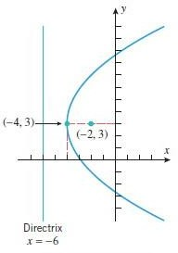
Solution The equation involves quadratic terms in y but none in x, so we first take all of the y- terms to one side:
y² − 6y = 8x + 23
Next, we complete the square on the y-terms by adding 9 to both sides:
(y − 3)² = 8x + 32
Finally, we factor out the coefficient of the x-term to obtain
(y − 3)² = 8(x + 4)
This equation is with h = −4, k = 3, and p = 2, so the graph is a parabola with vertex (−4, 3)
opening to the right. Since p = 2, the focus is 2 units to the right of the vertex, which places it at the point (−2, 3); and the directrix is 2 units to the left of the vertex, which means that its equation is x = −6.
Example Describe the graph of the equation
16x² + 9y² − 64x − 54y + 1 = 0
Solution This equation involves quadratic terms in both x and y, so we will group the x-terms and the y-terms on one side and put the constant on the other:
(16x² − 64x) + (9y² − 54y) = −1
Next, factor out the coefficients of x² and y² and complete the squares:
16(x² − 4x + 4) + 9(y² − 6y + 9) = −1 + 64 + 81
or
16(x − 2)² + 9(y − 3)² = 144
Finally, divide through by 144 to introduce a 1 on the right side:

Slide 5
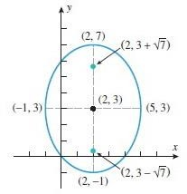
(𝒙 − 𝟐)^{𝟐}
(𝒚 − 𝟑)^{𝟐}
+ = 𝟏
𝟗 𝟏𝟔
This is an equation with h = 2, k = 3, a² = 16, and b² = 9. Thus, the graph of the equation is an ellipse with center (2, 3) and major axis parallel to the y-axis. Since a = 4, the major axis extends 4 units above and 4 units below the center, so its endpoints are (2, 7) and (2,−1). Since b = 3, the minor axis extends 3 units to the left and 3 units to the right of the center, so its endpoints are (−1, 3) and (5, 3). Since
𝑐 = √𝑎² − 𝑏² = √16 − 9 = √7
the foci lie √7 units above and below the center, placing them at the points (2, 3 +√7) and (2, 3
−√7)
Example
Describe the graph of the equation
x² − y² − 4x + 8y − 21 = 0
This equation involves quadratic terms in both x and y, so we will group the x-terms
Solution
and the y-terms on one side and put the constant on the other:
(x² − 4x) − (y² − 8y) = 21
(𝒙−𝟐)^{𝟐}
(𝒚−𝟒)^{𝟐}
by completing the squares that this equation can be written as
− = 𝟏
𝟗 𝟗
This is an equation with h = 2, k = 4, a² = 9, and b² = 9. Thus, the equation represents a hyperbola with center (2, 4) and focal axis parallel to the x-axis. Since a = 3, the vertices are located 3 units to the left and 3 units to the right of the center, or at the points (−1, 4) and (5, 4). c
= 3√2 , so the foci are located 3√2 units to the left and right of the center, or at the points (2 −
3√2, 4) and (2 + 3√2, 4)

Slide 6
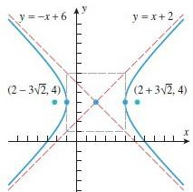
The equations of the asymptotes may be found using the trick of replacing 1 by 0
(𝒙 − 𝟐)^{𝟐} (𝒚 − 𝟒)^{𝟐}
− = 𝟎
𝟗 𝟗
This can be written as y − 4 = ±(x − 2), which yields the asymptotes
y = x + 2 and y = −x + 6
With the aid of a box extending a = 3 units left and right of the center and b = 3 units above and below the center,

